Slide 1
Semantic Analysis of Source Code in Object Oriented Programming A Case Study for C#
Claudiu Epure
June, 2015
Scientific Coordinator
Dr. Adrian Iftene

Slide 2
Contents
About the Project
Objectives
System Architecture
CSCRO Ontology
Sharprdf.Core Library
Sharprdf.Cmd Application
Demo
Technologies
Future Work
Conclusions

Slide 3
About the Project
Code Name: “Sharp RDF”
Problem - source code in large projects:
hard to read and maintain
hard to extract useful information
the new programmer has no idea about the code
it is not semantically described
Idea - semantic analysis of the source code:
programming language of choice: C#
create a C# source code ontology (OWL)
process the source code : (C#, OWL) => RDF
information retrieval via SPARQL
more: question answering via NLP

Slide 4
Objectives
C# ontology in Web Ontology Language (OWL): CSCRO
A library that produces a RDF graph from C# and OWL: Sharprdf.Core
A command line application, for automation purpose: Sharprdf.Cmd
An endpoint to query via SPARQL

Slide 5
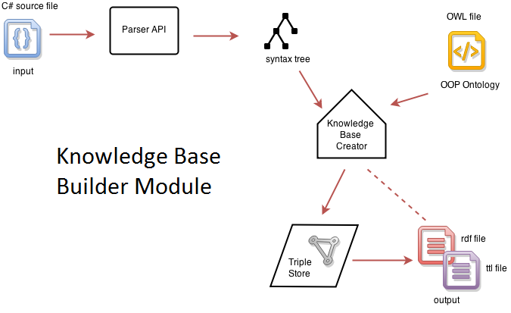
System Architecture

Slide 6
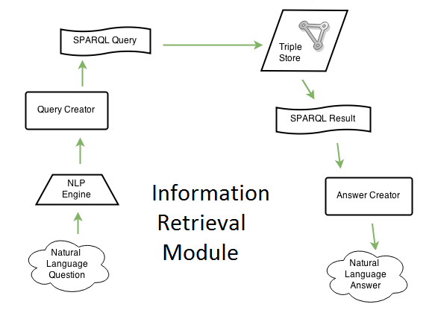
System Architecture (2)

Slide 7
CSCRO Ontology
C# Source Code Representation Ontology
Based on SCRO (an ontology for Java source code)
At first - adapted for C#
In the end - totally recreated for C#
Entities: Class, Namespace, Field, Method
Properties: hasType, hasModifier, isMemberOf
Annotations: creator, date, language
Demo in PROTÉGÉ

Slide 8
Sharprdf.Core Library
The “heart” of the project
Working steps:
maps the ontology entities to nodes in graph
creates the syntax tree of the input source code (using “Roslyn”)
creates the RDF graph based on the syntax tree and the ontology mapping
Is is used by other components:
command line, web application

Slide 9
Sharprdf.Cmd Application
Purpose:
use in continuous integration; create RDF graph at build
Usage:
> sharprdf –o cscro.owl –f Program.cs
Arguments:
- o (ontology)
- f (file): multiple files can be used
Output:
graph.rdf

Slide 10
Demo

Slide 11
Technologies
Languages
RDF, RDFS, OWL, C#
Libraries:
dotNetRDF, Stardog Server, Stanford Core NLP, Command Line Parser
Tools:
Protégé, Visual Studio, Stardog Server Application

Slide 12
Future Work
Detect advanced object oriented characteristics like inheritance, polymorphism, etc.
Detect design patterns in source code
Generate source code based on RDF (refactoring)
Question answering in natural language
Build an API to expose all the functionalities
Create a NuGet package and a Visual Studio extension

Slide 13
Conclusions
CSCRO ontology was created for C#
RDF graph is obtained from source code
Information is retrieved via SPARQL
Command line application is used for auto generating the graph on build (used in continuous integration)

Slide 14
References
Github page:
https://github.com/claudiuepure/sharprdf/
Project documentation:
http://students.info.uaic.ro/~claudiu.epure/disertatie/
Project site:
http://sharprdf.net/

